Slide 1
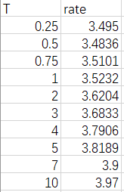
JSON Data Generation
Initial data：DATA.CSV
JSON DATA
{\"T\":[0.25,0.5,0.75,1,2,3,4,5,7,10],\"rate\":[3.495,3.4836,3.5101,3.5232,3.6204,3.6833,3.7906,3.8189,3.9,3.97]}

Slide 2
JSON Data Generation
R CODE:
library(rjson)
library(readr)
data <- read_csv("~/R/Home-Work-for-BDIF/data.csv")
json_ratedata <- toJSON(data,method = "C")
Data
json_ratedata

